Slide 1
Introduction to Concurrent Programming with GPUs
GPU Programming Specialization

Slide 2
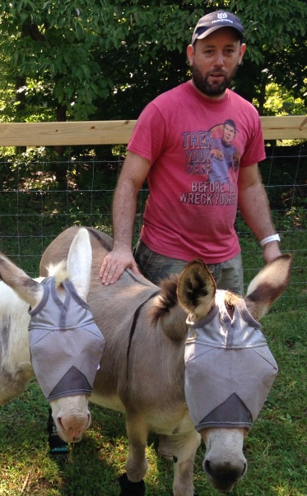
Who Am I?
Chancellor Pascale
Instructor JHU Whiting School
Software Developer for over 15 years
Skills/Interests
High Performance/Cloud Computing
Computer Vision
Web Application Development

Slide 3
Coursera GPU Specialization Overview
Intro to Concurrent Programming with GPUs
Introduction to Parallel Programming with CUDA
CUDA at Scale for the Enterprise
CUDA Advanced Libraries

Slide 4
Introduction to Concurrent Programming with GPUs Description
This course will help prepare students for developing code that can process large amounts of data in parallel. It will focus on foundational aspects of concurrent programming, such as CPU/GPU architectures, multithreaded programming in C and Python, and an introduction to CUDA software/hardware.

Slide 5
Introduction to Concurrent Programming with GPUs Objectives
Summarize core principles of hardware and software that allow for scalable data processing
Write code that runs in concurrent threads in multiple languages
Apply NVidia’s CUDA software/hardware architectures for developing software that utilizes GPUs in order to process 1000s of data points simultaneously
Create software that demonstrates usage of GPUs with CUDA

